Slide 1
Working in partnership to deliver Social Prescribing 7 November 2018
Jennifer Jones Rigby - COO, Health Exchange
Chloe Jennings & Lisa Harland - Health & Wellbeing Partners
Dr Vish Ratnasuriya - Chair, Our Health Partnership
Notes:
OHP in partnership with Health Exchange has been successful in its bid from the Health and Well Being Fund to introduce a Social Prescribing programme across the OHP Practices in Birmingham.
Thank you to the partners that actively supported and helped shape the bid: UK Active, Birmingham City Council, West midlands Police Service, west Midlands Combined Authority, Birmingham City Council, Birmingham and Solihull Mental Health Trust, Birmingham Community health Foundation Trust, BVSC,

Slide 2
TODAY…
Who is Health Exchange?
Why work in partnership?
How social prescribing helps individuals
Examples of different social prescribing models and outcomes
How we will introduce social prescribing across the OHP network

Slide 3
What is social prescribing
Social prescribing is a way of linking patients in primary care with sources of support which are typically provided by voluntary and community sector organisations
Social prescribing provides GPs with a non-medical referral option that can operate alongside existing treatments to improve health and well-being
Examples of activities include gardening, befriending, cookery and a range of sports
Notes:
main current issue is:
The current range of services are fragmented and they are not centred on primary care. Therefore, when a patient presents to their GP there is little knowledge or training about the services that are available, making it difficult to access from the consulting room. Where there are Community Link Workers and social prescribing programmes operating in Birmingham, the services have been developed to deal with a particular need and not to create a whole system solution.
It is difficult to evaluate, monitor and measure the effectiveness of what is currently happening due to the system being so fragmented and been operated by so many different organisations, this is an issue when attempting to develop a system wide approach.
Later on in the presentation – will be sharing what some of the different models of social prescribing schemes look like. You will also see how the models can be adapted to target your local priorities within your localities. The key to all of this is us, the GPs to be working in partnership with our allocated Health & Wellbeing Partner. Health Exchange bring with them a wealth of experience and expertise in this area.
Experience suggests that social prescribing schemes can become popular very quickly. It’s important to ensure that local community services are ready for the likely increase in the take-up of their services. This means ensuring that they are properly supported, resourced and able to meet increasing need. This is where working in partnership with Health Exchange is important.
Would like to now pass on to onto Jennifer, Chloe and Lisa who are going to tell us about Health Exchange and the scheme.

Slide 4
Working in partnership to deliver social prescribing
Jennifer Jones - Rigby

Slide 5
Health Exchange - SMT Overview JJR
Manage
Manage Long term conditions
NDPP – Pre Diabetes
Type 2 - Diabetes
Motivate
Health Trainer in my pocket – APP
Individuals/Insurers
Prevent – Live Well Take Control – pre-diabetes
Workstyle – Resilience support
LWTC
Health Exchange
Started in 2007 with 23 staff and 4 services
Now have staff over 88 at 3 key sites and work across the UK and Internationally with Easy Care Health
8 key services and several projects
COPD programmes
BVI – Body scanning
Warwick - Peoples History
Social Prescribing

Slide 6
Vision:
The vision for Health Exchange is that:
We will drive the personal and corporate health and wellbeing movement throughout the United Kingdom. We will do this by revolutionising the way we support the prevention and management of the key negative and preventable health conditions
We will help individuals build resilience at home, work and in communities leading to improved productivity, increased economical growth locally, nationally and internationally by 2025
We will create a year on year surplus that can be reinvested into new and innovative technological responses to positive health creation that will enable the offer of both to business directly and to individuals positive health behaviour change

Slide 7
Our Mission
To enable everyone to have the capability and confidence to choose positive health and wellbeing and to shape the design and development of health and wellbeing services
Our core values :
Investing … in our people by employing local people and helping them to develop their skills and knowledge
Being the best … at providing services that meet the needs of every individual commissioner
Social value … by spending money in a way that benefits the local communities where we work
Innovation … by creating new ways of working which continue to make our services more efficient and engaging
Empowerment … talking to our clients to build on their skills and knowledge so that we can create new solution

Slide 8
Core Values….We believe in:
Investing… in our people by recruiting local people and helping them to develop their skills and knowledge
Being the best… at providing services that meet the needs of every individual, commissioner or buyer of our services
Social value… by spending money in a way that benefits the local communities where we work
Innovation… by creating new ways of working which continue to make our services more efficient and engaging
Empowerment… talking to our clients to build on their skills and knowledge so that we can create new solutions

Slide 9
Health Exchange Global 2020

Slide 10
About social prescribing
Social prescribing creates a formal means of enabling primary care services and other appropriate frontline providers to refer patients with social, emotional or practical needs to a variety of holistic non clinical services (e.g. Make and Taste Community Cooking Programme; Walking for Health Group; Green Gyms / Gardening groups)
Social Prescribing has been recognised as an effective means of meeting the needs of patients due to an enhanced recognition of the social, economic and cultural factors which impact on mental wellbeing. The holistic approach to social prescribing is therefore viewed as an appropriate alternative to medical explanations and treatments of mental distress with outcomes such as:-
Improving mental health
Improving sense of wellbeing
Reduced social isolation
Notes:
Branding, J. and House, W. (2009) social prescribing in general practice: adding meaning to medicine. British Journal of General Practice 59(563)
Rogers, A. and Pilgrim, D. (1997) the contribution of lay knowledge to the understanding and promotion of mental health. Journal of Mental Health 6(1)

Slide 11
Health Exchange social prescribing in Solihull
Linking Primary Care with community agencies that can help meet the psycho-social needs of patients

Slide 12
Social prescribing something we have been doing for some time
Support Plus
Quality of Life for Older People
Edgbaston Wellbeing Hub
Gift Exchange
Social Prescribing and Wellbeing Coordinators

Slide 13
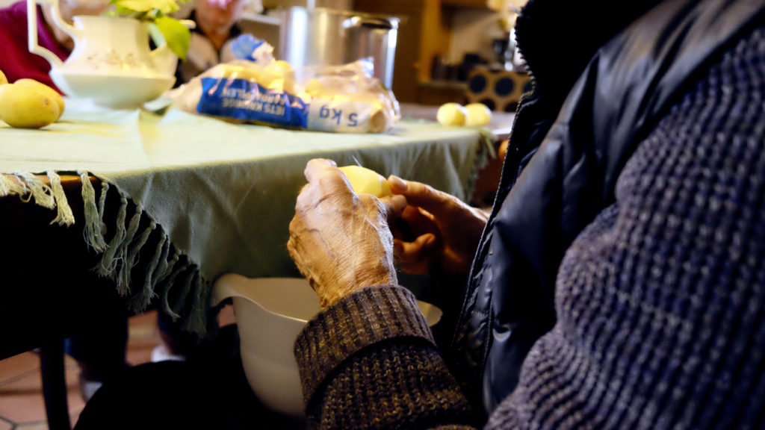
Mrs Hall
Mrs Hall’s Story – Solihull Social Prescribing
“The Social Prescribing service has given me a purpose to my day… I have learned that I am not alone in this world.”
Notes:
Mrs Hall is 51 years of age and has suffered with depression most of her adult life. She has been admitted to a psychiatric ward on a number of occasions. She has always received support from psychiatrists and her GP at Lyndon Clinic. Recently, she was referred to the Social Prescribing service because she was feeling very low and isolated.
Before her engagement with Health Exchange, Mrs Hall approached her GP having been discharged from Lyndon Clinic where she was seeing a psychiatrist regularly. The appointments were to make sure she was coping and review her anti-depressant use. Her mood was very low and she was struggling to find the confidence to join groups or organisations.
Mrs Hall was referred to the Social Prescribing Service to help her to access social activities. As a result, Mrs Hall is now engaged in voluntary work with Warwickshire Wildlife Trust, every Thursday.
She chose the Wildlife Trust because she enjoys being out in the open and amongst nature. She wanted a calming and quiet place where she could help and also enjoy the outdoors and the natural surroundings. She found the people at the trust are young, enthusiastic and very friendly. It has given her something to do which is what she felt she needed.
She has also started the Doc Spot at Tudor Grange Leisure Centre and is currently going to the gym once a week, which she will be increasing to twice a week.
Mrs Hall has become much more engaged and involved with the community. She wanted to do something to challenge her mind so she plucked up the courage to attend The Reading Café. She found the small group of people who attend are interesting, friendly and have a wealth of knowledge on all genres of books. She has also been on a walk with the Striders and Strollers group at Hobs Moat Library. She found the walk relaxed and got talking to other walkers and was pleased she had attended.
Social Prescribing has given her a timetable which gives structure to her week and allows her to do the activities she enjoys. She is now attending a variety of groups. In her own words: ‘’It has given a purpose to my day, it has made me go out and attend the classes and get involved with voluntary work. I was hibernating at home and not socialising enough before. I still have to push myself to do the activities, with time this should become easier and my life should improve. I have learnt new skills at Warwickshire Wildlife Trust, along with learning to socialise again. At the gym I have a programme to improve my fitness level and I am learning about my body’s limits as I improve my fitness. I have learned how to lose myself in a book, even for a short amount of time. I have also learned that I am not alone in this world and there are people who, for whatever reason, attend groups to meet and socialise with other people, to share common interests and to get pleasure from doing so.’’
“Thank you [to my facilitator] for helping me to get involved with all of these groups. The Health Exchange is doing a wonderful job.”

Slide 14
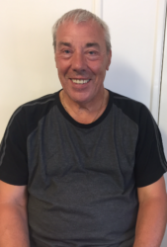
Mark’s Story – Solihull Social Prescribing
“The activities I was introduced to through the Solihull Social Prescribing Service are keeping me mentally sound and helping me to enjoy my life to the full.”
Notes:
“The activities I was introduced to through the Solihull Social Prescribing Service are keeping me mentally sound and helping me to enjoy my life to the full.” Mark is 70 years old and a recent retiree. When he was working, he had long shifts and little time to spend

Slide 15
Social prescribing client journey
Chloe Jennings & Lisa Harland
Health & Wellbeing Partners
Notes:
The Client Journey
1) Referred to service
- GP, Self referrals – can be online via website or email and we also take telephone referrals
Take details of client that we need in order to determine suitability and to contact again
2) Health & Wellbeing Partner allocated referral to conduct assessment. Client is contacted within 2 days, assessed with 2 weeks. Assessment consists of questionnaire that help practitioner to determine any issues with mental health, social well-being, financial wellbeing. We try to understand the clients life circumstances and areas that they feel they might need some more support in.
Allows the Health & Wellbeing Partner an insight into what is affecting client and how we might support them to improve their wellbeing... [Person-centred]
3) Health & wellbeing partner refers client to services agreed – this is slightly different for every person as we take a person centered approach, but the person can be referred for psychological therapy if needs be. Other places we have recently referred/signposted people to are places they can volunteer with animal, community yoga classes, exercise groups (Pat Bensons Boxing Academy), Cooking classes at the childrens centre, gardening groups. All of these things support long term well-being.

Slide 16
Social prescribing client journey
1) Referred to service
GP or Self
2) Client is allocated to a Health & Wellbeing Partner and assessed
3) Health & Wellbeing Partner refers client to services agreed
Notes:
The Client Journey
1) Referred to service
- GP, Self referrals – can be online via website or email and we also take telephone referrals
Take details of client that we need in order to determine suitability and to contact again
2) Health & Wellbeing Partner allocated referral to conduct assessment. Client is contacted within 2 days, assessed with 2 weeks. Assessment consists of questionnaire that help practitioner to determine any issues with mental health, social well-being, financial wellbeing. We try to understand the clients life circumstances and areas that they feel they might need some more support in.
Allows the Health & Wellbeing Partner an insight into what is affecting client and how we might support them to improve their wellbeing... [Person-centred]
3) Health & wellbeing partner refers client to services agreed – this is slightly different for every person as we take a person centered approach, but the person can be referred for psychological therapy if needs be. Other places we have recently referred/signposted people to are places they can volunteer with animal, community yoga classes, exercise groups (Pat Bensons Boxing Academy), Cooking classes at the childrens centre, gardening groups. All of these things support long term well-being.

Slide 17
Social prescribing client journey
5) Client goes on to receive agreed support to try and help them with areas they identified as needing support with
4) Client then either takes steps to access services discussed or is put on waiting list to receive certain services
Notes:
4) Client then either takes steps to access services discussed or is put on waiting list in order to receive certain services (psychological therapy) – explain that this can be an anxiety provoking time for client, so Health & Wellbeing Partner tries to engage with them as much as possible – maybe a phone call or a text to catch up with the client, providing them useful services in the meantime.
5) Client goes on to receive agreed support to try and help them with areas they identified as needing support in in the assessment. This could be therapy for anxiety, depression, relationships, anger issues. Could be very specific such as a befriending service to reduce loneliness, support with finances. The client could begin attending a walking group, a photography or dance class.
6) The client is reviewed in 3 months after the initial assessment to see if they have benefitted at all from any of the agreed support – their circumstances may have changed or they have experienced various barriers, so at the review stage it is a case of going over this and attempting to amend to current situation.

Slide 18
The benefits of social prescribing
Case Study
“Thank you very much for your support and opening the door for me and my son to access different activities and services. When I originally got your call I was apprehensive as I didn’t know what was out there. I was surprised to see that there are a lot of places to go and things to do. Now I am looking to more activities, meet people and socialise whilst my son is accessing a drama group and will be part of a play. Thank you very much for your support.”
“Thank you for being reliable, supportive and having a calm and approachable demeanour. Thank you for following things up when you said you would, I was confident in your ability to support me.”
“You did make a difference in the way that I feel about myself and my life. It helps a lot knowing that there is somebody who is able to listen when you need it most.”
“I want to really thank you all, I really appreciate everything that you do and it does really help”
Practical benefits
Reduction in anxiety/depression symptoms
Improved physical health
Improved confidence & self esteem
Improved social health & healthier relationships
More autonomy/control
Notes:
How social prescribing helps individuals
Case study;
This client referred herself and her son. Her son was feeling lonely, demotivated and was struggling with self esteem issues. She felt unsure of how to best support him going forward, so referred just to try a different pathway. The practitioners spent time getting to know first her teenage son and identified/suggested him trying different activities in the community, such as attending a drama group to help build his confidence. He attended the drama class and it improved his confidence tremendously, resulting in him auditioning for and getting a part in a local drama production.
The mother also then spoke to practitioners. Her concerns for her son had left her feeling a little lonely, so she wanted support to access local activities. It was suggested that exercise can help people to feel healthier and can also help you to socialise, and so she started attending local exercise classes after a discussion about different exercises that she would enjoy.
Other compliments;
Clients often outline that just speaking to someone about how they are feeling is therapeutic in themselves. Practitioners give clients the space and time to talk about how they are feeling, and brain storm solutions to their current situation, which in itself helps the client to move forward. Practitioners show kindness, compassion and genuine concern for the health of clients because not everyone has the support of loving, supportive families or friends. They might also be experiencing other barriers that stop them from achieving these goals such as financial barriers, lack of confidence, anxiety/depression, health concerns and many more. Working together with a professional can provide the crucial support needed to make life changes that support the client in the long term.
The practical benefits are wide-ranging. We have seen improvements in clients mental health, physical health, confidence & self esteem, relationships and many more. It all really depends on the person, their circumstances and where they want to see change, but we aim to give them the information to take control and make more informed decisions regarding their wellbeing.

Slide 19
What kind of activities are available for individuals?
Psychological therapy
Gardening and horticultural therapy
Exercise
Hobbies & Leisure
Volunteering
Work & finance
Eating well
Religion, culture, spirituality
Meeting people
Notes:
Psychological therapy
Offers support to people with anxiety disorders, depression, low self esteem, relationship/anger issues.
Gardening has known positive effects for body & mind, social element to it as well.
- Exercises – BeActive schemes across Council run gyms, yoga for wellbeing, Pat Bensons boxing academy in Digbeth for clients with mental health issues, walking groups
- Hobbies & Leisure - drama groups, photography groups, community fun days
- Volunteering – animal therapy, volunteering to help other vulnerable people – uses time meaningfully
Work and finance – Thrive into work schemes, support with managing finances
Religion, culture and spirituality – Karis Neighbourhood Scheme/Listening and guidance,
Meeting people – social meetups, coffee mornings community days, places of welcome.

Slide 20
What do different models of social prescribing schemes look like?
3 typical components of social prescribing
Based on the original descriptions of social prescribing, a social prescribing scheme can have three key components –
a referral into the service,
a consultation with a health & wellbeing partner using motivational interviewing and coaching skills, and
an agreed referral to a local voluntary, community and social enterprise organisation
Notes:
VISH
To say that the general principles of a social prescribing model comprise 3 components.
Health & Wellbeing Partners may have a variety of names including link worker, health advisor, health trainer, care navigator, community connector, community navigator, social prescribing co-ordinator, and community care co-ordinator.
These roles aim to understand what matters to the person and to link them with appropriate support.
These principles can be applied to different models to target different local priorities… here is an example of 4 models that have be deployed….

Slide 21
Targeting local priorities with different social prescribing schemes
Notes:
VISH – looking at other case studies it is evident that you do not want to be adopting a ‘one size fits all’ approach … important that each locality works with their relevant Health and Wellbeing Partner to establish a model / scheme that will work to target the areas of priorities.
There are lots of examples of models that have been adopted across the UK,

Slide 22
Model 1 - Lion Health Practice in Stourbridge
a) 3+ long term conditions
b) Poorly controlled diabetic
c) BMI greater than 40
d) Newly diagnosed hypertension
e) Recent TIA/COPD/Asthma/CVD
f) Diabetic or pre Diabetic
Target:
Outcomes:
80% diabetics improved HbA1c
26% diabetics took HbA1c below 48
50% At Risk took HbA1c below 42
15 % patients lose 5% or more of body weight
• Only 7% drop out rate
Notes:
There are lots of examples of models that have been adopted across the UK, want to give you a quick snapshot of some of these …
This is from a model adopted by Lion Health Practice in Stourbridge (practice population 32,000) that targeted patients with low motivation and specific health problems
Example 1 - The Lion Health Practice in Stourbridge – population size 32,000 – see notes below for how this worked…
1.Pick your patient with any of the following;
a) 3+ long term conditions
b) Poorly controlled diabetic
c) BMI greater than 40
d) Newly diagnosed hypertension
e) Recent TIA/COPD/Asthma/CVD
f) Diabetic or pre Diabetic
2. Establish IT model for recording progress –Lion Health use EMIS
3.Refer to Health Coach (or in our case this would be a Health & Wellbeing Partner)
4. Health Coach spends an hour with the patient and talks about their existing situation in a holistic sense and set goals and sets parameters for on going contact but also establishes what is known as their Patient Activation Measure;
1=disempowered and overwhelmed
2=Becoming aware but still struggling
3=Taking Action
4=Maintaining behaviours and pushing through
5.A key part of the process is helping the patient to move from 1 to 4 and then real change can take place
6.Over the year of the project with support all patients improved their Patient Activation Measures leading to the following outcomes;
• 80% diabetics improved HbA1c
• 26% diabetics took HbA1c below 48
• 50% At Risk took HbA1c below 42
• 15 % patients lose 5% or more of body weight
• 55% group are male
• Only 7% drop out rate

Slide 23
Model 2 – Eastleigh
Target:
Older vulnerable patients
Half of the patients referred by the primary care team, and
half come from telephoning all older people discharged from hospital
Outcomes:
Reduced hospital admissions for frailty
Reduced GP appointments
Reduced home visits
Reduced social isolation
Notes:
From Page 2 – Social Prescribing in Wessex… this is one of the 8 services providing social prescribing in Wessex.
Care Navigators in Eastleigh Southern Parishes
Provided by a GP Federation, this is a team of 5 Care Navigators (CN) with one attached to each General Practice. They primarily support older vulnerable patients, with whom them develop a holistic plan covering care coordination and connection with the local voluntary sector. Patients are supported for as long as they need it, which on average is for 6.5 weeks. Half of the patients are referred by the primary care team and half come from telephoning all older people discharged from hospital. The team of 4 CNs provide a 7-a day service, with one CN being on duty at the weekend. This service has now been fully commissioned (was originally pumped primed by the CCG)

Slide 24
Model 3 – Top 2% attendees
Identify the top 2% of people who attend frequently for problems that the practice cannot solve
Target:
Outcomes:
Marked reduction of GP appointments
Addressing of mental health co-morbidity
Addressing of social determinants of health

Slide 25
Model 4 – No targeting
Target:
In Cullumpton, Devon, GPs and practice nurses from three GP surgeries make referrals to a link worker, who has an office in one of those surgeries
The link worker offers appointments to support and motivate people in order to make changes to their health. They do this by accessing support available both in the local community and at the GP surgery
Improved health and wellbeing
Addressing social determinants of health
Reduction of GP appointments
Outcomes:
Notes:
VISH
Some social prescribing schemes refer people via practice staff such as GPs and practice nurses. Practice nurses who see people with specific conditions, such as diabetes, are well placed to identify suitable people for referral.
Example In Cullumpton, Devon, GPs and practice nurses from three GP surgeries make referrals to a link worker, who has an office in one of those surgeries. The link worker offers appointments to support and motivate people in order to make changes to their health. They do this by accessing support available both in the local community and at the GP surgery.
Example Wigan Community Link Worker service which is jointly commissioned by Wigan Borough CCG and Wigan Council. Professionals from primary care, the hospital and social care make referrals to a link worker.
Source: from page 22 - Making Sense of Social Prescribing

Slide 26
Implementation
Rolled out by networks based on the Extended Access hubs
Hall Green Health Centre (phase 1)
Lordswood House Medical Practice (phase 1)
ROH (phase 1)
Oaks Medical Centre
Harlequin Surgery
Iridium Medical Practice
Ley Hill Medical Practice
Locality leads confirmed for phase 1

Slide 27
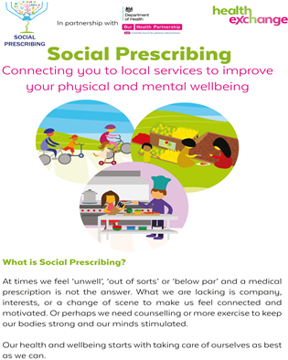
How will patients be made aware of this social prescribing service?
The Patient Participation Group will be notified
OHP website
Leaflets & posters available in practices
Word of mouth
Text messages to eligible patients
Targeted communications campaigns

Slide 28
Next Steps
November 2018
3 Health & Wellbeing Partners in post
Locality leads to meet with Health & Wellbeing Partners to establish a suitable model
Roll out
November 2018/December 2018
Recruit an additional 4 Health & Wellbeing Partners

Slide 29
Questions

Slide 30
THANK YOU

